Slide 1
Introduction to R

Slide 2

R we ready?
R is a powerful language and open-source software environment for statistical modeling, data management, and graphics.
R is available for all platforms Windows, Mac, and Unix/Linux.
It is supported by a worldwide repository system, The Comprehensive R Archive Network (CRAN), https://cran.r-project.org/.
Why R? From S plus, by Ross Ihaka and Robert Gentleman at the University of Auckland, New Zealand.
Notes:
I’m going to try to sell you all R… it’s going to be hard to sell something that’s free, but I will try!
R evolved from S plus. Named the alphabet R based on the first initials of the a certain pair of gentlemen named Ross Ihaka and Robert Gentleman.

Slide 3
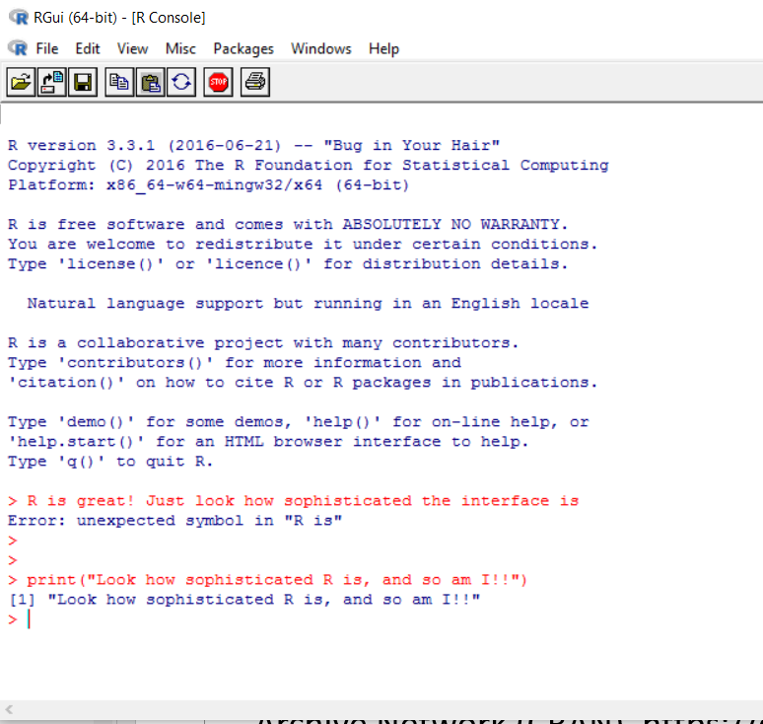
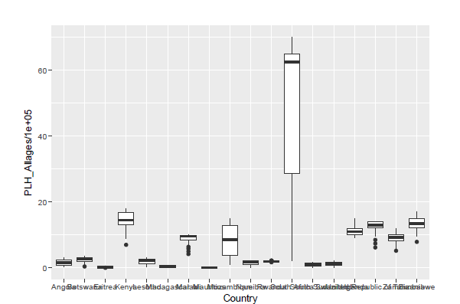
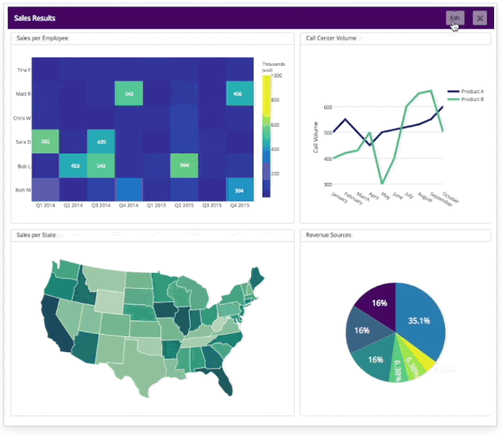
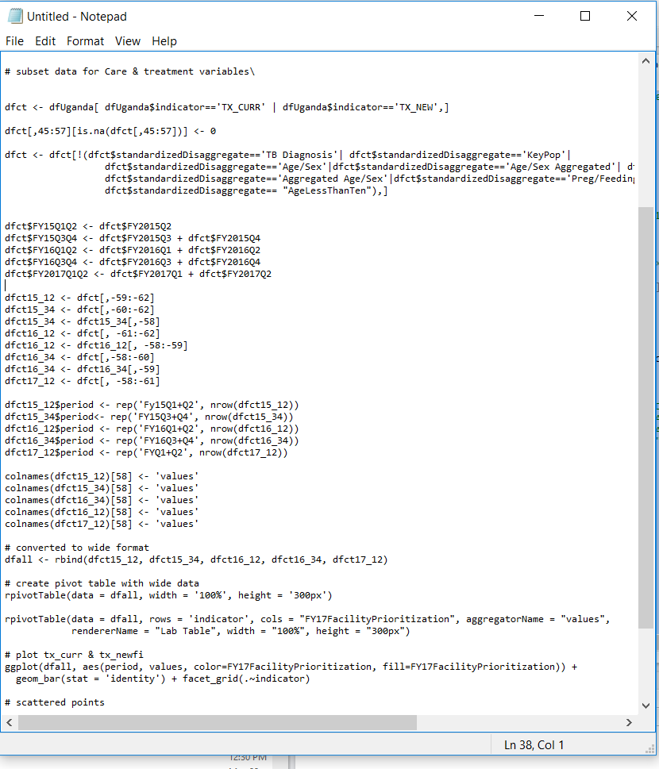




R-evolution
R software has come of age!
More that 4400 add-on packages
18,000 community members
Sum total of human distributed intelligence powering R development
Notes:
R has evolved considerably since it’s inception, from S plus, to basic statistical operations, to bioinformatics, plain graphing interface, to full dashboards in vibrant colors.
I feel it has finally come of age, with 18,000 developers.

Slide 4

Resistance. is. futile. you. will. be. assimilated
Developers can write software for R and freely distribute it as add-on packages for R.
CRAN contains thousands of user contributed R add-on packages to supplement the base R distribution, packages such as the sea package that will be used for subnational estimation.
Open Source
Usability
Intuitive coding syntax
Extensibility
GIS
Plethora of options for visualization, color, and formats
Modularity
Free!!!
SAS, STATA
Large community of developers
Continual evolution
Good documentation of packages
MS Excel
Oracle (ODBC)
C/C++, Java, Python, Fotran
All type of analysis

Slide 5
R Extensibility
R packages allow R to read and write data to SAS, SPSS, STATA, Excel, and many other software.
R can be used to connect to Oracle databases using Open Database Connectivity (ODBC) programming interface.
Programming languages such as C/C++, Java, Python, and Fortran can be called from within R and can call R functions.
SAS and SPSS also have add-ons that allow for connecting to R.

Slide 6


Reasons not to use R software
Paradox of choice – decision paralysis!!
Too many bright Shiny objects.
Sound weird talking in R lingo with strange package names :
“Did you geom_jitter that ggplot in plotly, and put it in a Shiny App?”
Enables certain personality disorders:
Obsessive Compulsive
Addictive
Control freqs
Megalomaniacal
Biostatisticians

Slide 7
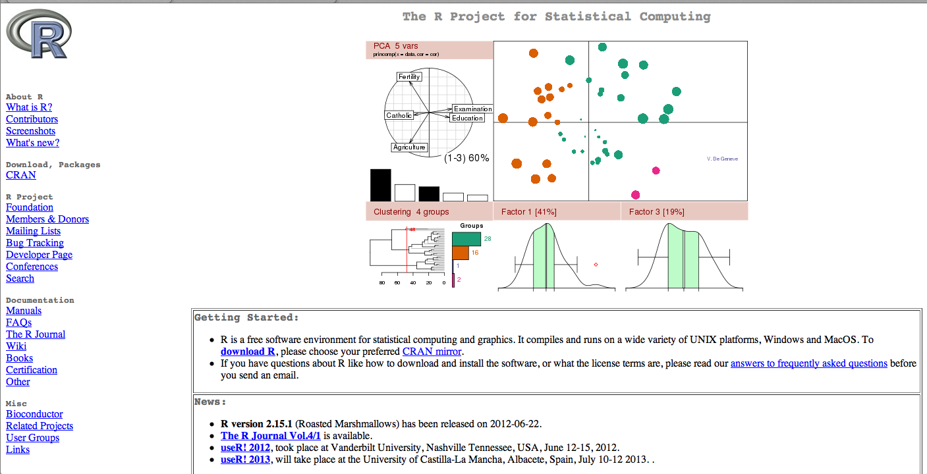
R installation
To install R on your MAC or PC you first need to go to http://www.r-project.org/.

Slide 8
RStudio Interface
RStudio provides a user-friendly working environment for R.
It is available for Windows, Mac, and Unix/Linux.
R software must be installed first before installing RStudio.
You cannot run RStudio without a current R installation.
RStudio is an integrated development environment (IDE) for R.
It includes many useful features such as
a four-panel layout that includes a console for interactive
R sessions, a source code editor, and panels with
notebooks to organize less central components
tools for plotting
debugging tools
administrative tools for managing packages, the workspace, files, and more.
In short, using RStudio can make using R a lot easier for first time R users.

Slide 9
Remember
Use help(function name) or ?"function name" to get
documentation on a function (e.g., help(mean) or ?mean).
R is case-sensitive
Values are assigned to variables in R using \<-.
Anything entered after #, before being submitted for execution, is interpreted as a comment.
When copying code from this document, remove the command \>"
and continuation \+" prompts from the script before running in R.

Slide 10
wRangling data
Read .csv, .txt, .xlsx files
read.csv, read.delim, read.xlsx, read.table
df <- read.csv(“Users/folder/test.csv", header = TRUE, stringsAsFactors = TRUE, sep =“\t”)
Install packages to read large files faster – data.table, readr
RODBC - Connect to database
library(RODBC) connection <- odbcConnect("<DSN>")
R data structures: scalar, vector and factor, array, data frame, list
Data frames most common – matrix format – each column is a vector
Vector types – character, numeric, factor, integer
Call columns: df[[8]], df[[PSNUuid]], df$PSNUuid, df[,PSNUuid] or df[,8]

Slide 11
R data Export
Export csv, txt, xlsx files from R
write.csv(file_name, “Users/folder/file_name.csv”, row.names = F, na = “NA”)
Export plots from R
Plot(x,y)
dev.copy(jepg, filename = “plot.jpeg”)

Slide 12
Really easy way to do basic analysis
R Keyboard Shortcut
Ctrl+R to run highlighted script in the editor window.
Ctrl+L to clear the console window.
Esc key to terminate a command submitted in R.
Brackets [] are used to extract elements from vectors.
> v<-1:30
> v[5:10]
[1] 5 6 7 8 9 10
Data checks – colnames(), head(), subset()
Descriptives – summary(), table(), aggregate()
Data manipulation – cbind(), rbind(), new variable (df$new_var), drop rows/ columns

Slide 13
Ridiculous syntax quirks you’ll want to know
Operator | Descriptio
< / > | Less than / greater than
<= / >= | Less than or equal to / greater than or equal to
== | Exactly equal to
!= | Not equal to
!x | Not X
x | y | x or y
x & y | x and y
isTrue(x) | Test if x is true
na.rm = T / F | Remove or keep na values

Slide 14
Resources you may find useful
Help window or rdocumentation.org – provide R resources and help pages for all base R functions and packages.
Stack Overflow for questions and answers
R-bloggers, r4stats, r-statistics for R news and tutorials
Data visualization - flowingdata.com
Free online courses: DataCamp, EdX
Fox, J. (2005). R commander: A basic-statistics user interface to R. Journal of Statistical Software. 14, (9), 1-42.
Teetor, P. (2011). 25 Recipes for Getting Started with R. Sebastopol, CA: O’Reilly Media Inc.
Teetor, P. (2011). R cookbook. Sebastopol, CA: O’Reilly Media Inc.
Crowley, M. J. (2007). The R Book. Chichester, New England: John Wiley & Sons, Ltd.
A Google search will provide millions of sites for addition R resources.

Slide 15


Slide 16
QUESTIONS?

